Slide 1
FOREX
By: Anna Pedroni, Kamsy Nwokedi, Freeman Fang & Alin Alzaidy

Slide 2

Introduction to forex
Forex, short for foreign exchange, is a global financial market where currencies are traded.
It serves as a platform for individuals, businesses, and institutions to exchange one currency for another.
Forex is used for various purposes, including international trade, investment, and speculation on currency price movements.

Slide 3
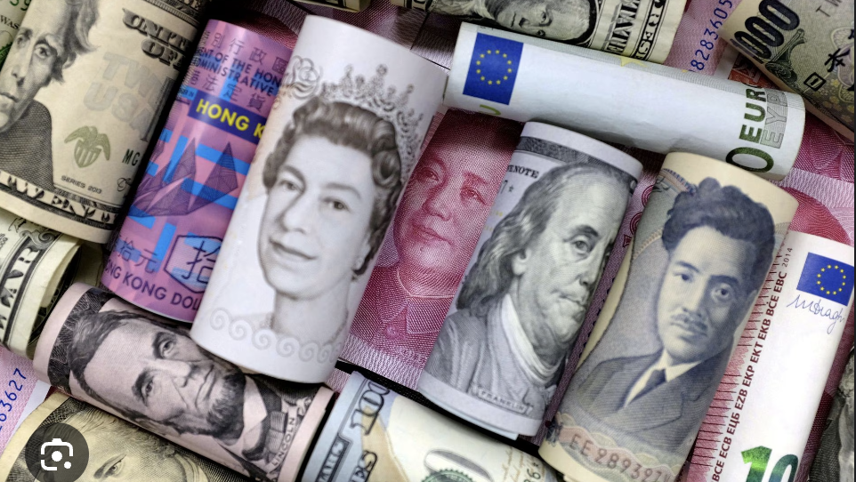
CURRENCY COMPARISONS
In this context, we'll compare exchange rates involving the British Pound (GBP) against the Euro (EUR), US Dollar (USD), Swiss Franc (CHF), and Hong Kong Dollar (HKD).

Slide 4
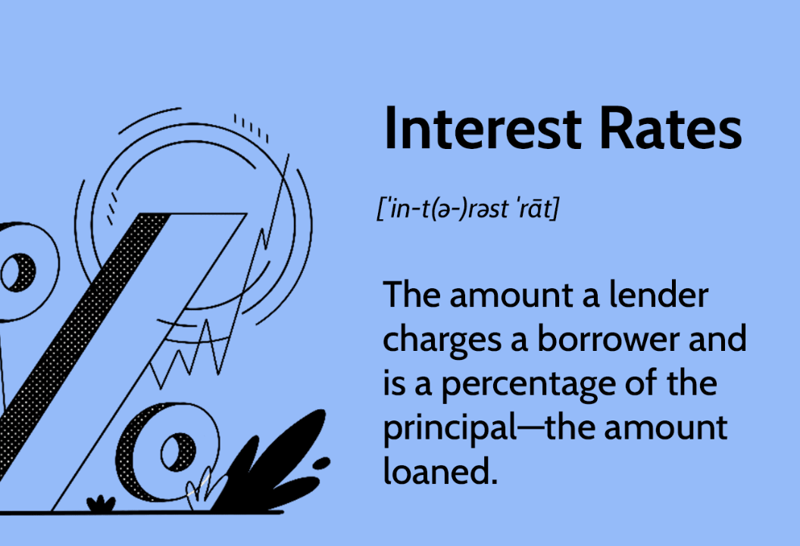
Interest rates
They are set by central banks to control inflation, stimulate or cool down economic activity, and influence the exchange rate by affecting the attractiveness of a currency for investors.
Accessing how forex rates affect interest rates in the Bank of England and the European Central Bank involves monitoring how currency fluctuations impact inflation and economic conditions, which in turn influence the central banks' decisions on lending rates.

Slide 5
Interest rates
Bank of England | European Central Bank
BoE has a BASE RATE aka bank rate, aka interest rate that is used to influence other rates in the UK, including rates for loans, mortgages and savings accounts. https://www.bankofengland.co.uk/explainers/why-are-interest-rates-in-the-uk-going-up | ECB has 3 KEY INTEREST RATES: Deposit Facility Fixed Rate Tender Marginal Lending https://data.ecb.europa.eu/main-figures/ecb-interest-rates-and-exchange-rates/key-ecb-interest-rates

Slide 6
GETTING the data: FOREX exchange rates
Insert
some
Notes
@Freeman

Slide 7
GETTING the data: Interest rates
Downloaded from the BoE and ECB databases through their APIs with a Python script
Loaded as Pandas dataframes, transformend into a matching format and merged into one single .csv file
.csv data in 5 columns:
Date as AAAA-MM-DD
BoE base rate
ECB deposit facility
ECB fixed rate tender
ECB marginal lending
BoE & ECB
databases
Python script: ETL
CSV file:
Date, rate1, rate2, …

Slide 8
ANALysis
SOMETHING
HERE :)

Slide 9
Analysis
SOMETHING
HERE :)

